Slide 1
US FINANCIAL CRISIS
NAME
INSTITUTION
COURSE
DATE

Slide 2
1990-2000 US Economic history
From 1990 to 2000, the house prices increased rapidly due to factors such as reduced interest rates, over-generous lending as well as speculation.
A credit crises emerged due to simultaneous crashes in the housing bubble as well as other asset bubbles.
There was a web of financial innovations introduced to reduce the risk hence spreading the crisis among the financial markets and the real economy.
The profit-seeking financial organizations employed complex financial processes including inadequate risk analysis, highly leveraged borrowing, and limited regulations leading to betting on one outcome.
Notes:
Before September 2000, the US governing institutions focused on addressing liquidity concerns, stimulating demand, and preventing mortgage foreclosures.

Slide 3
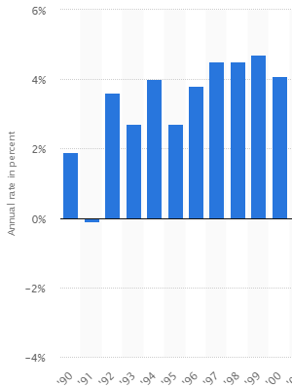
GROWTH DOMESTIC PRODUCT (GDP)
Notes:
The graph represents the Real Growth Domestic Product rate in the US from the year 1990 to 2000. GDP can be defined as market value of the total produced goods and services within a nation in a specific period of time. The Real GDP has been adjusted for the changes in price, as the deflation or inflation and is linked to the 2009 U.S dollar value. The Real GDP is calculated by subtracting the ending value from the beginning value and then dividing by the beginning value. All the other years report a positive GDP except 1991. In this period, the GDP was negative because there was a decline in the real income, low amounts of industrial production, a decrease in retail and wholesale sales, and heightened unemployment rate.

Slide 4
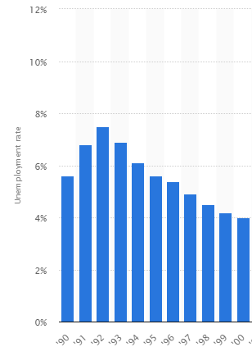
Unemployment rate
Notes:
The graph above shows the rate of unemployment in the United States from the year 1990 to 2000. Unemployment is described as a condition whereby employed people are either laid off, quits, or fired from their work and still searching for a job. In 1990, the unemployment rate was 5.6% and increased in 1991. The major cause of such increase in unemployment is that US introduced new rules and regulations that discouraged most of the companies from hiring and also restricted the unemployed persons from taking the jobs. The US government played a significant role in increasing unemployment and welfare payments, enforcing rules concerning when and where the businesses will should operate. As a result, most of the regulations became very intrusive such that most of the businesses decided to place limits on their hiring. The rate of unemployment has been calculated through dividing the number of the unemployed persons by the total amount of the individuals on the civilian labor force.

Slide 5
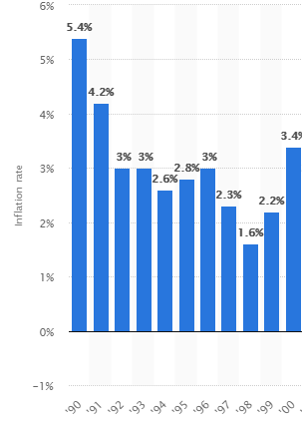
Inflation rate
Notes:
The data above represents the US’s unadjusted annual rate of inflation from the year 1990 to 2000. The data shows the U.S city averages. In economics, the rate of inflation is a measure of inflation calculated as percentage change rate in the level of price over time. 1990 was the period when US ha a high rate of inflation. This was because of the changes in the consumer confidence. The rate of unemployment was low and the wages stable. The consumers became over confident and spend more money. Such confidence drove up the prices since the providers and manufacturers charged high prices fro the highly demanded goods and services.

Slide 6
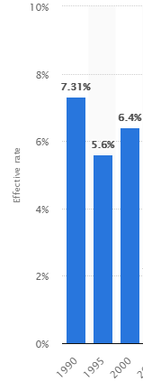
INTEREST RATES
Notes:
The graph above reflects the effective federal funds rate in the US from the year 1990 to 2000. In 1990, the interest rates were at 7.31%, the highest level compared to 6.4% in 2000. Such a high interest rate was mainly caused by the high rate of inflation in the same year. Inflation affected the level of the interest rate because when inflation is higher, the lenders always demand more interest rates as a compensation for the purchasing power decrease. Interest rates can be described as the cost of borrowing money.

Slide 7
references
Diamond, D. E., & Guilfoil, J. D. (1973). United States economic history. Morristown (N.J.: General Learning Press.
United States. (2010). The state of the United States economy and financial markets: Hearing before the Committee on Banking, Housing, and Urban Affairs, United States Senate, One Hundred Tenth Congress, second session, on the state of the United States economy and financial markets, Thursday, February 14, 2008. Washington: U.S. G.P.O.

